Slide 1

Travel Management System
Presented By:
Anshul Sharma (002789548)
Parjita Munshi (002761776)
Snehashis Lenka (002772221)

Slide 2

About Project
The goal of this Travel Management System is to make users' travel experiences safe, simple, and enjoyable by enabling them to check available modes of transportation, manage their stay, and visit nearby attractions by renting or booking a car. We also provide users with a safe and secure travel experience through our insurance policies.

Slide 3

Problem Statement
Travel agencies must pull up their socks to keep up with changing market trends and consumer behavior because travelers are choosing smart travel. Maintaining credibility and visibility is the most difficult challenge for travel agencies. Many travel agencies lack an effective online presence. Having a company website is also insufficient. Travelers are always looking for something different, whether it is experiential travel, leisure travel, eco-travel, or something else. People's daily lives have become more hectic, and they hardly have time to shop for groceries, let alone plan an entire trip. They would not want to go through a complicated and time-consuming booking process given their hectic schedules.

Slide 4





Our Systems' Specifications
User can book flights
User can book buses
User can look for hotel rooms to stay and can book table and explore different types of food at nearby restaurants
Can rent a car for roaming around places at their time and convenience.
Can take insurance and enjoy trip safety.

Slide 5
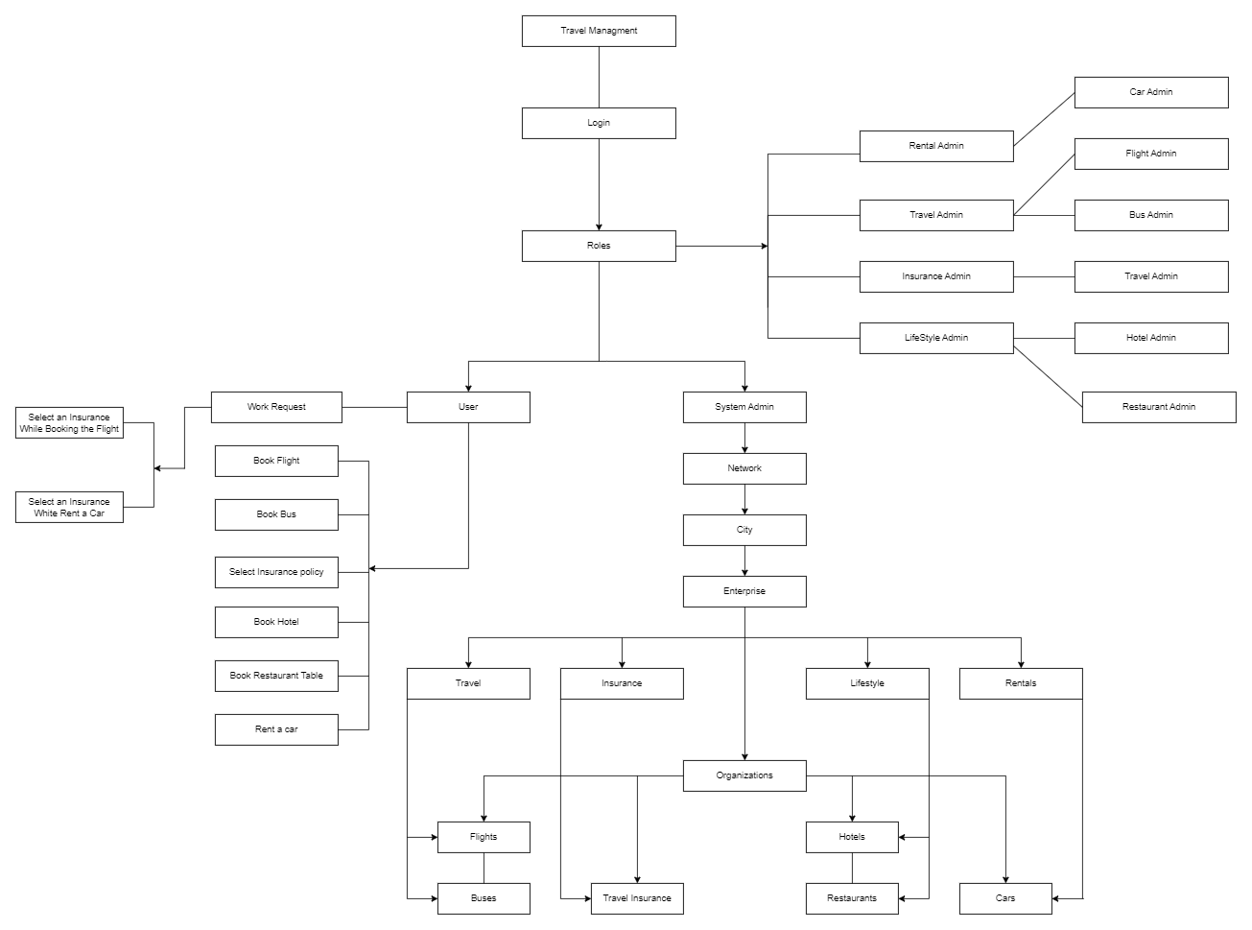

Slide 6
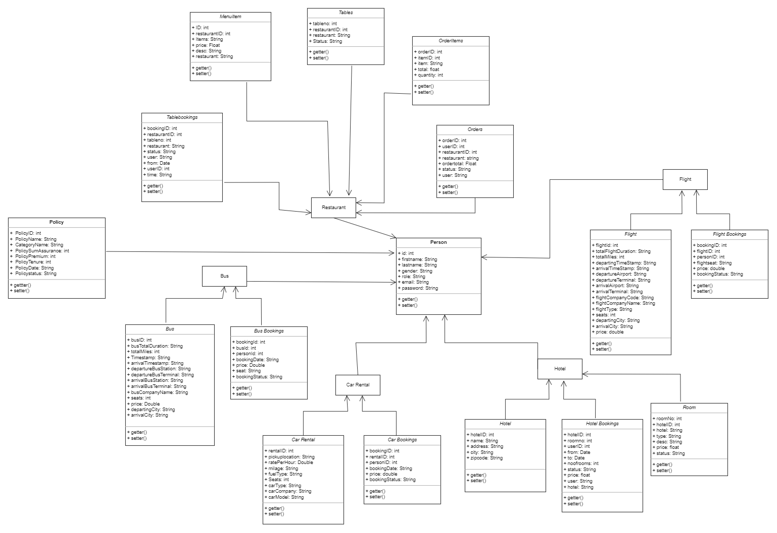

Slide 7
